Slide 1

Security
Computer System Engineering, Fall 2019. (IPADS, SJTU)
Introduction
Yubin Xia

Slide 2
Performance VS. Security

Slide 3
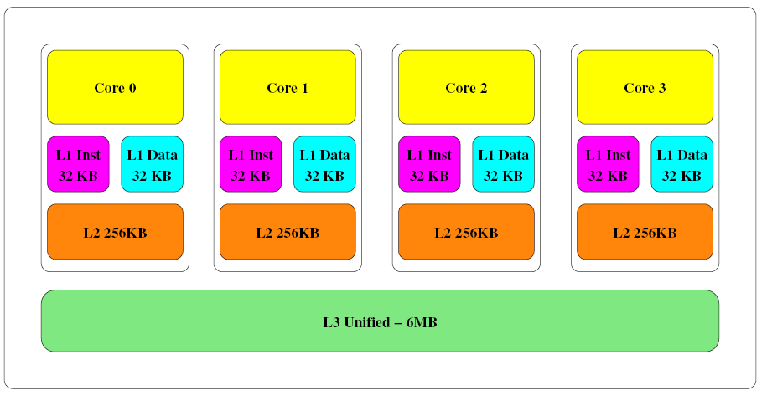
Recall: Last Level Cache is Shared

Slide 4
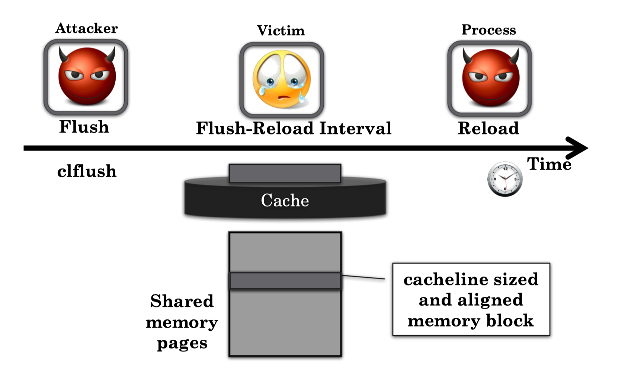
Flush + Reload Attacks
slow-­‐> no access
fast-­‐> access

Slide 5
Flush + Reload Attacks
Exploits cache behavior to leak information on victim access to shared memory
Attacker monitors victim's access to shared code
Attacker can determine what vic6m does
Attacker can infer the data the vic6m operates on

Slide 6
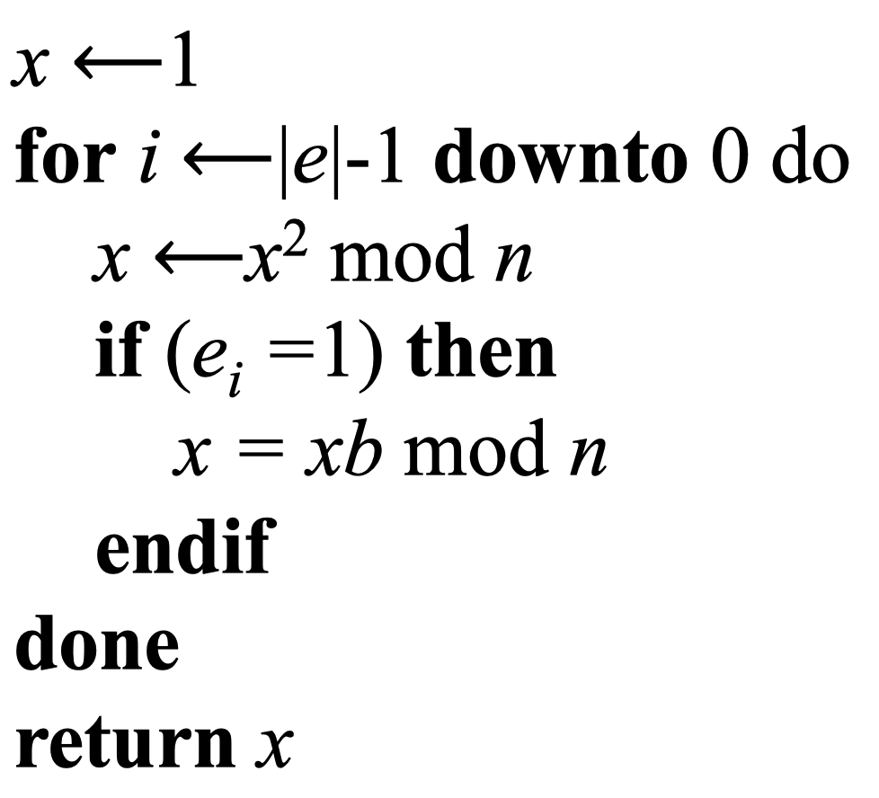
Square-and-Multiply Exponentiation in RSA
Scans the exponent (e) from the MSB to the LSB
For clear bits (0)
Square-­‐Reduce
For set bits (1)
Square-­‐Reduce
Multiply-­‐Reduce
The sequence of operations reveals the (secret) exponent e

Slide 7
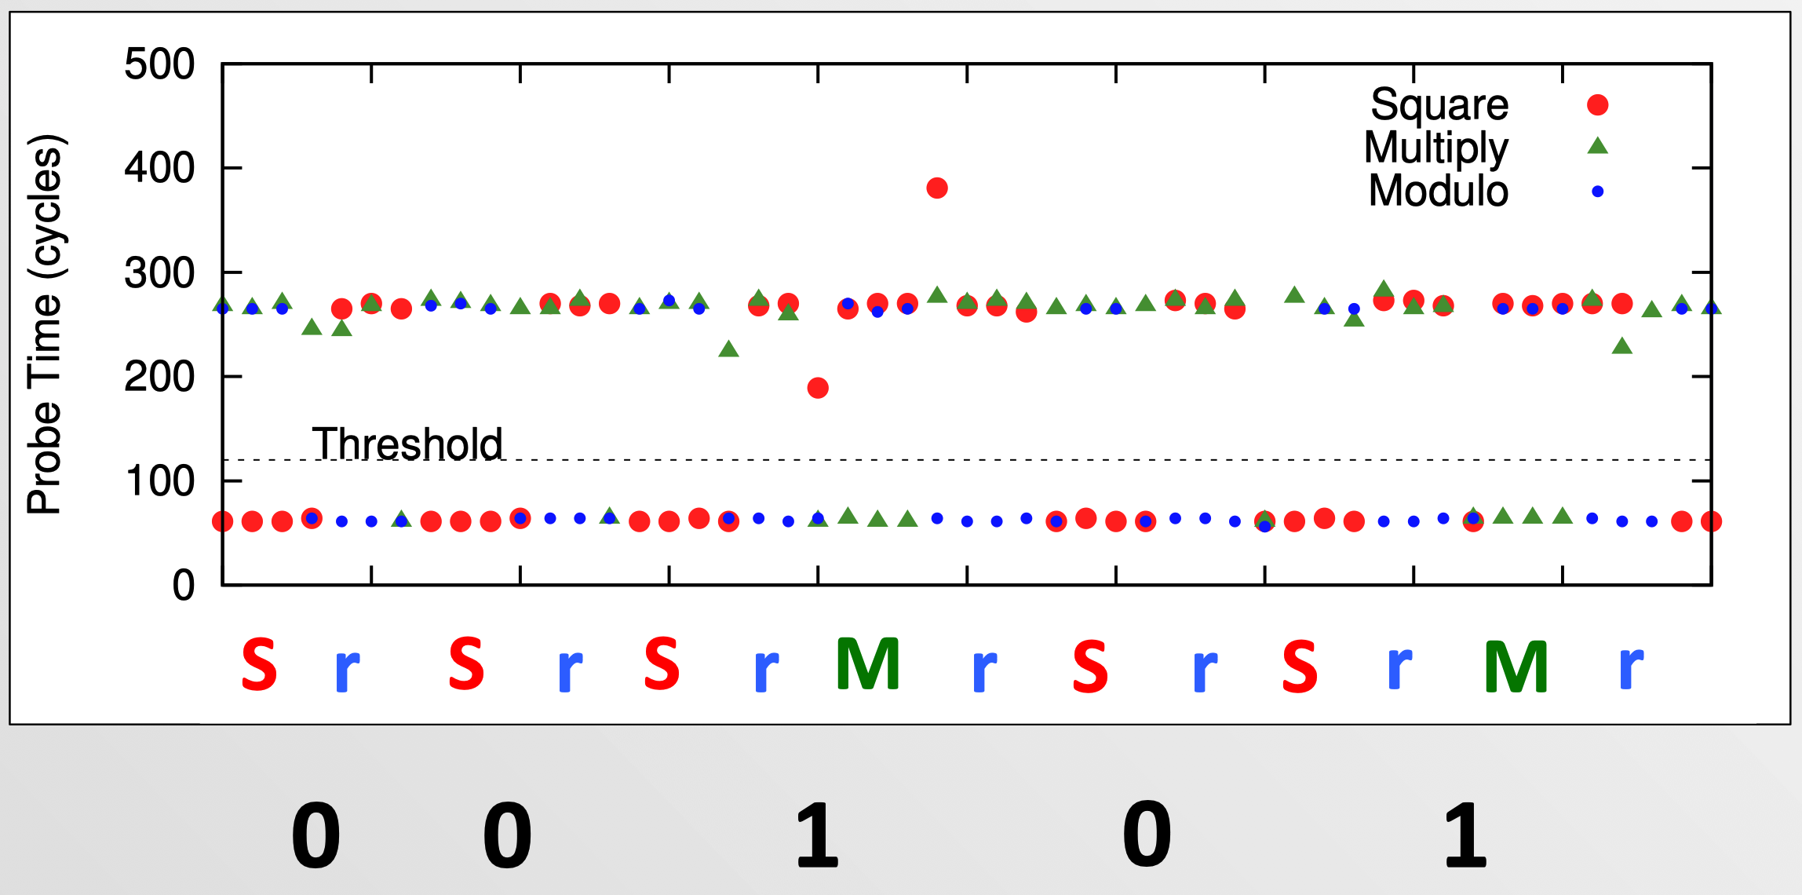
A Sample Trace

Slide 8
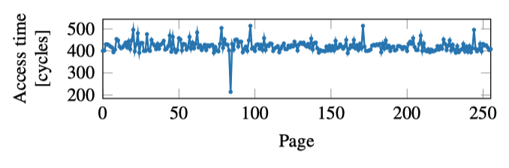
Cache Side Channel
Infer data by memory access time!
if (x)
mov %eax a[0];
else
mov %eax a[1];

Slide 9
Lessons Learned
Sharing could be dangerous
What if we do not share?
Hurt performance

Slide 10
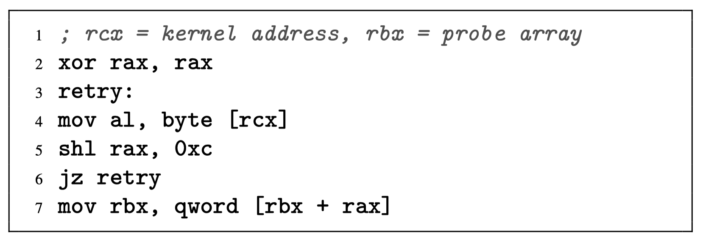
The Meltdown Vulnerability
An inaccessible kernel address is moved to a register, raising an exception.
Subsequent instructions are executed out of order before the exception is raised, leaking the data from the kernel address through the indirect memory access.

Slide 11


The Meltdown Vulnerability
key = 0x01
Mapped with kernel privilege in page table
Kernel
User
Access key
Permission Error!

Slide 12

Meltdown
key = 0x01
Mapped with kernel privilege in page table
Kernel
User
Meltdown
Can access key!

Slide 13

Meltdown
CPU
Instruction
Effect
Cache
Memory
key = 0x01
Kernel
User
Meltdown

Slide 14
Meltdown
CPU
Instruction
Effect
Permission Error!
1
Load key, %rax
%rax = 1
Reorder
Execution
Load buf[%rax], %rbx
Access buf[1]
2
Cache
Memory
key = 0x01
Kernel
Key = 1
… | buf[0] | buf[1] | buf[2] | … | buf[n] | …
User
Meltdown
buf
(Attack buffer)

Slide 15
Meltdown
CPU
Instruction
Effect
Permission Error!
1
Load key, %rax
%rax = 1
Reorder
Execution
Load buf[%rax], %rbx
Access buf[1]
2
Rollback status
w/o cache status!
Exception
3
Cache
Memory
key = 0x01
Kernel
2
Key = 1
buf[1]
… | buf[0] | buf[1] | buf[2] | … | buf[n] | …
2
User
Access
buf[1]
Fill buf[1]
to cache
Meltdown
buf
(Attack buffer)

Slide 16
Meltdown
CPU
Instruction
Effect
Permission Error!
1
Load key, %rax
%rax = 1
Attacker finds that buf[1] is in the cache, so that key equals to 1!
Reorder
Execution
Load buf[%rax], %rbx
Access buf[1]
2
Rollback status
w/o cache status!
Exception
3
Cache
Memory
key = 0x01
Kernel
2
Key = 1
buf[1]
… | buf[0] | buf[1] | buf[2] | … | buf[n] | …
2
User
Access
buf[1]
Fill buf[1]
to cache
Meltdown
buf
(Attack buffer)

Slide 17
Lessons Learned
Speculation could be dangerous
What if we do not speculate?
Hurt performance

Slide 18
Security Intro

Slide 19
Attacks Happen
Lots of personal info stolen
Attackers broke into server w/ ~800K records on Utah patients
Phishing attacks
Users at ORNL tricked by phishing email about benefits from HR
Millions of PCs are under control of an adversary
Which is called "Botnet"
Stuxnet
Infected Iran's uranium processing facilities
Fake certificate

Slide 20
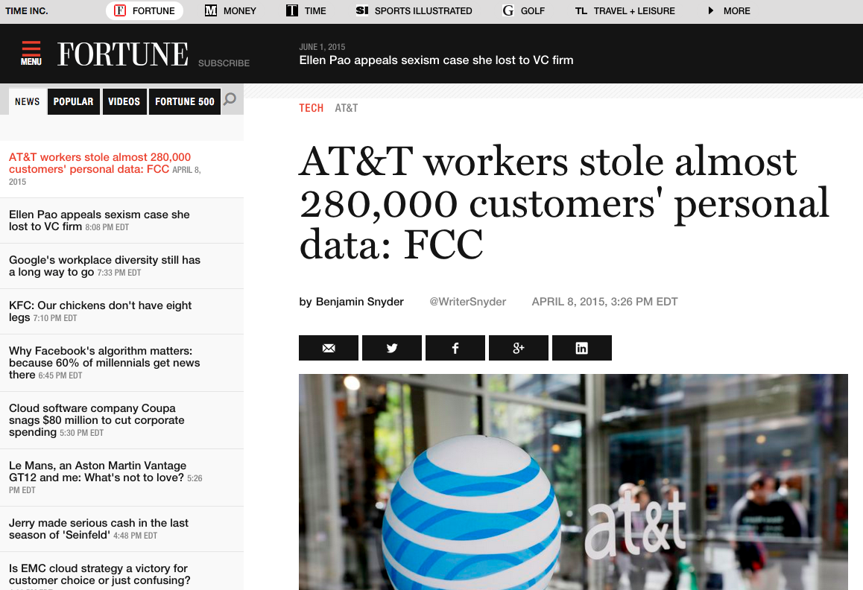

Slide 21
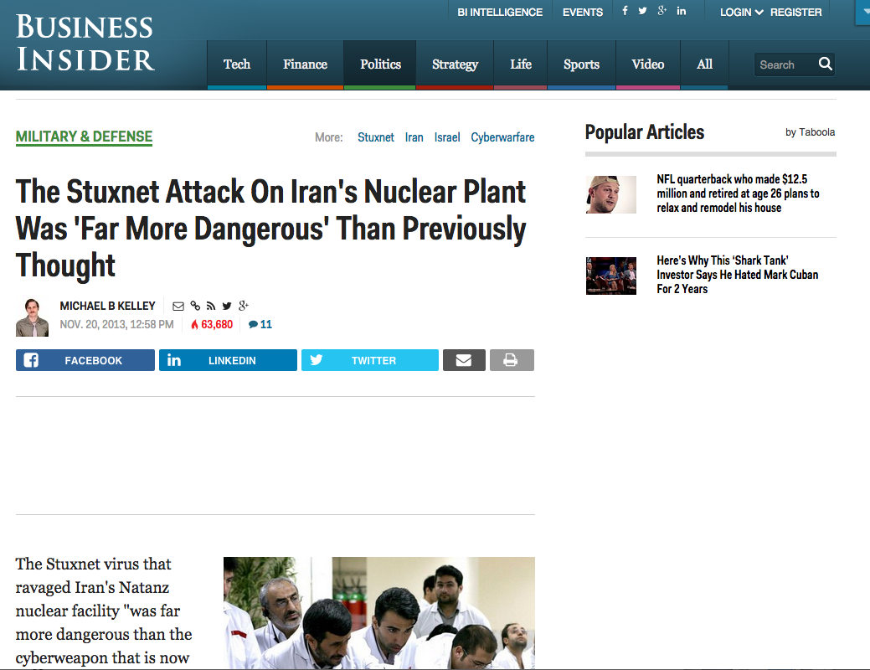

Slide 22
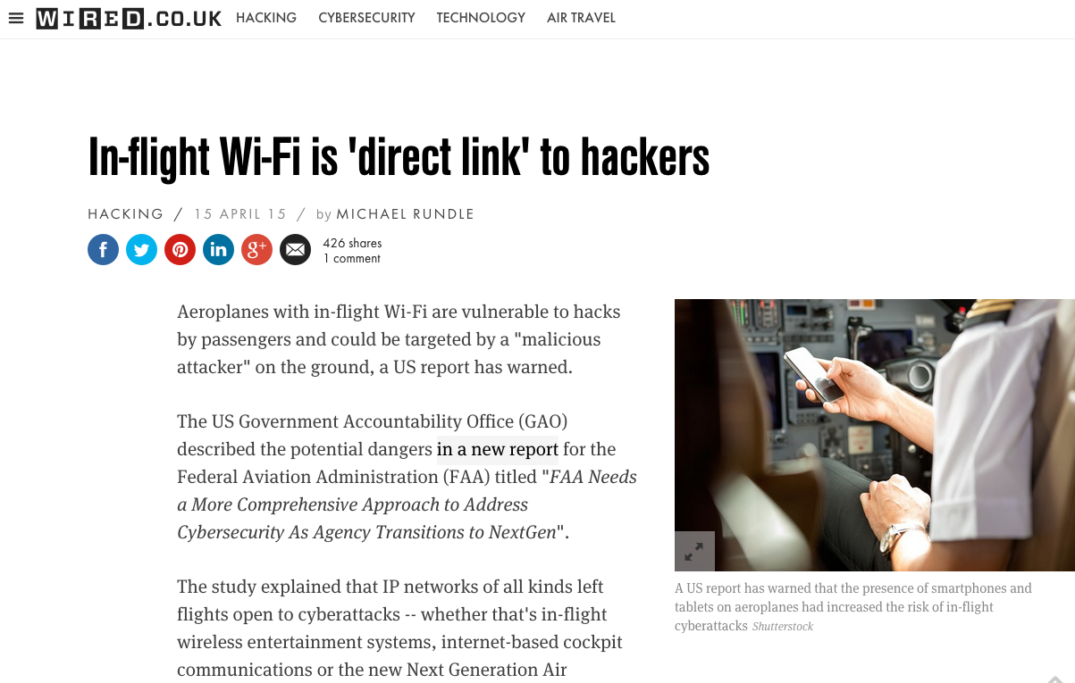

Slide 23
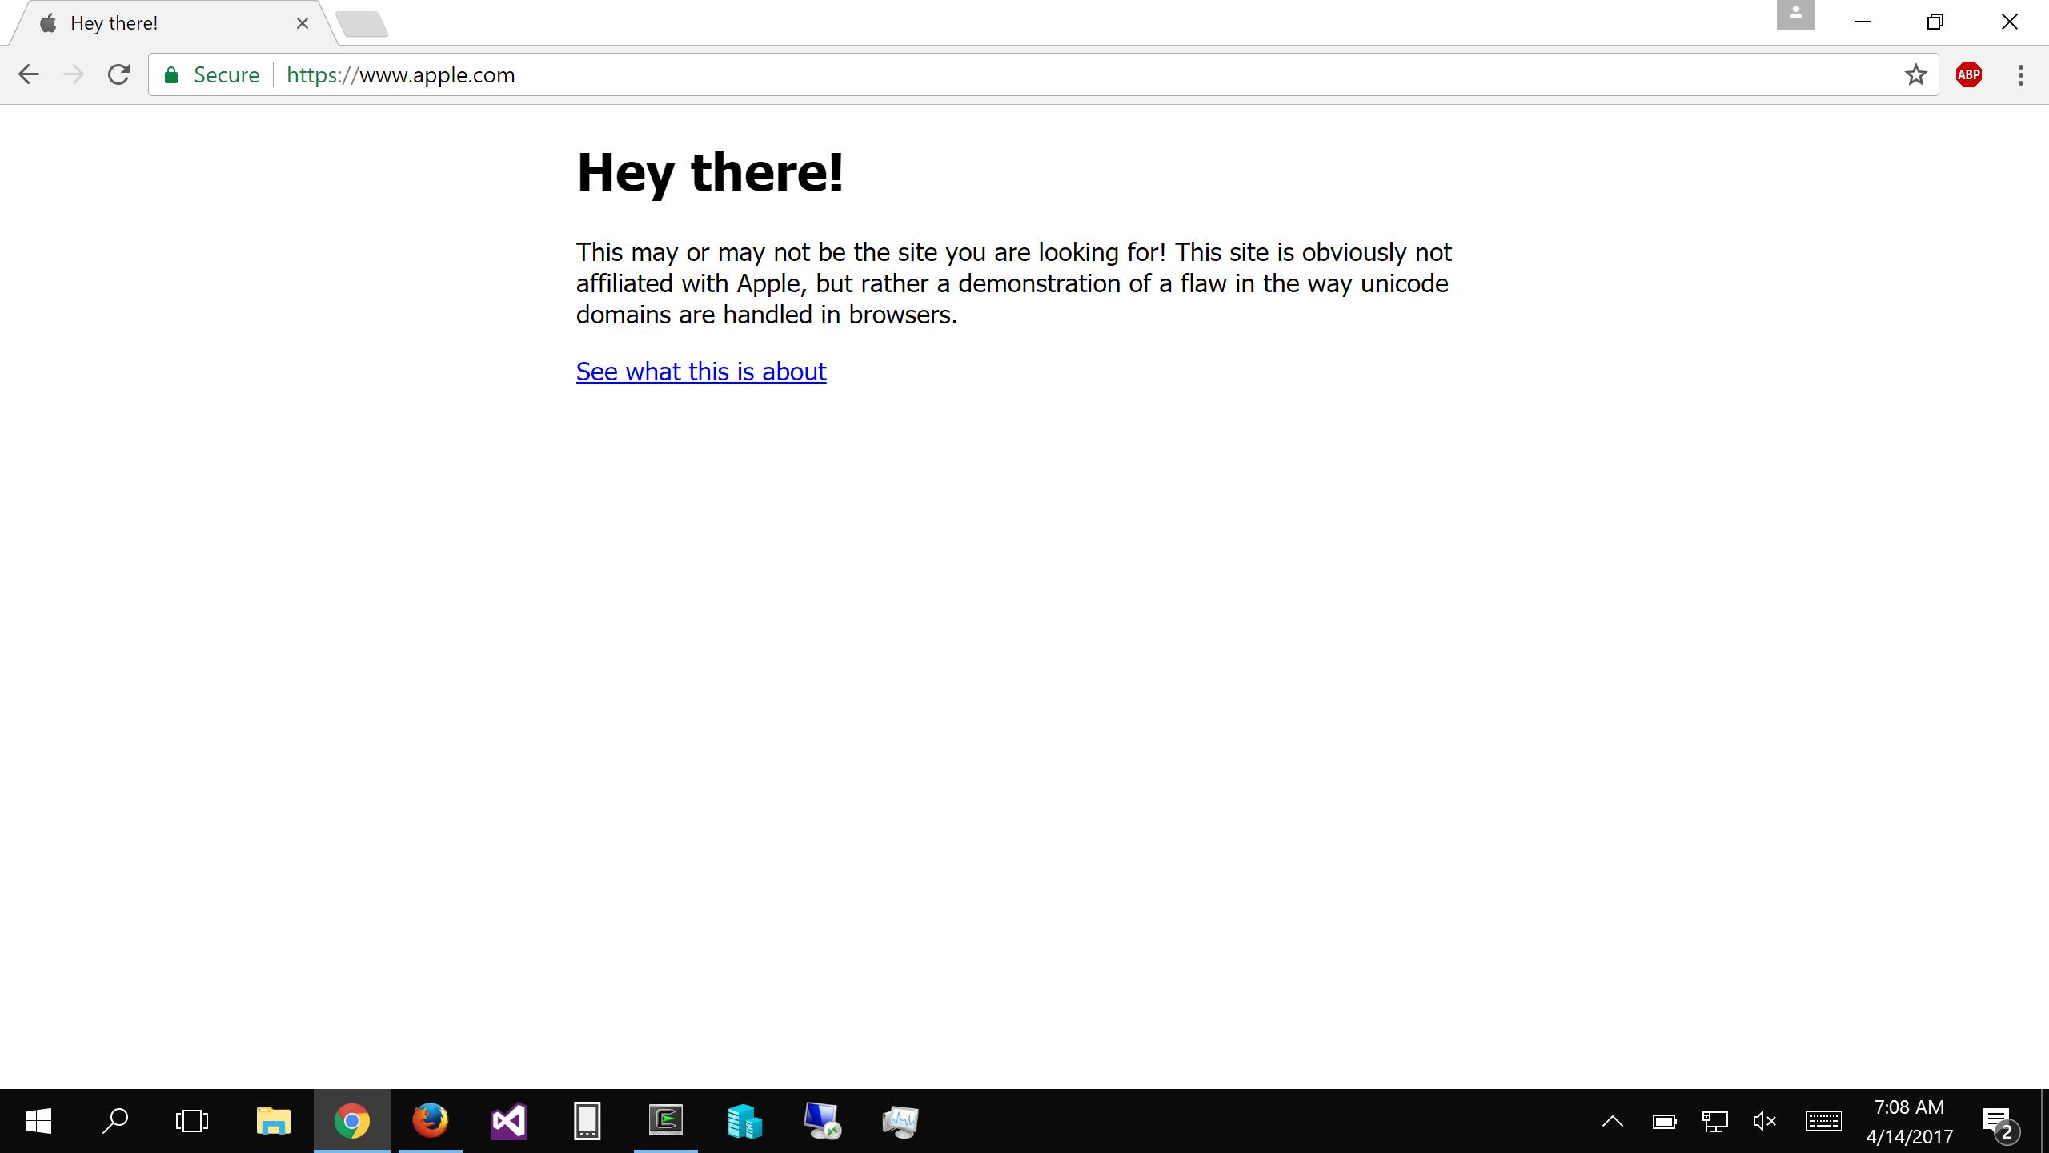
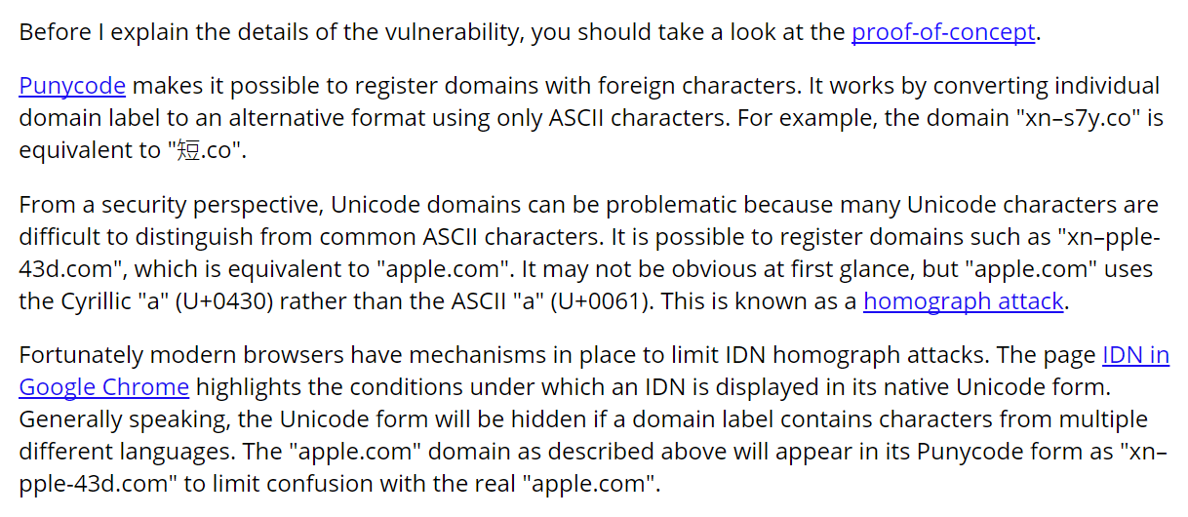

Slide 24
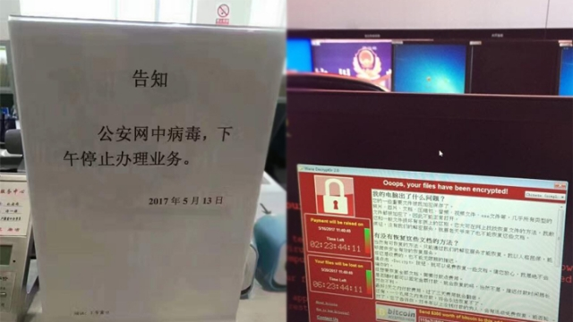

Slide 25



.
HOW TO SHOP FOR FREE ONLINE (S&P'11)
Chuck, pay in Amazon with this signed letter:
Amazon, I want to pay with this letter
Great, I will ship order#123!
Dear Amazon,
order#123 is $10, when it is paid, text me at 425-111-2222. [Jeff's signature]
Jeff,
I want to buy this DVD.
Dear Amazon,
order#123 is $10, when it is paid, text me at 425-111-2222. [Jeff's signature]
Jeff
Hi,
$10 has been paid for order#123.
[Amazon's signature]
Shopper Chuck
Amazon
Note: phone number is analogous to the URL that Amazon uses to notify the merchant

Slide 26
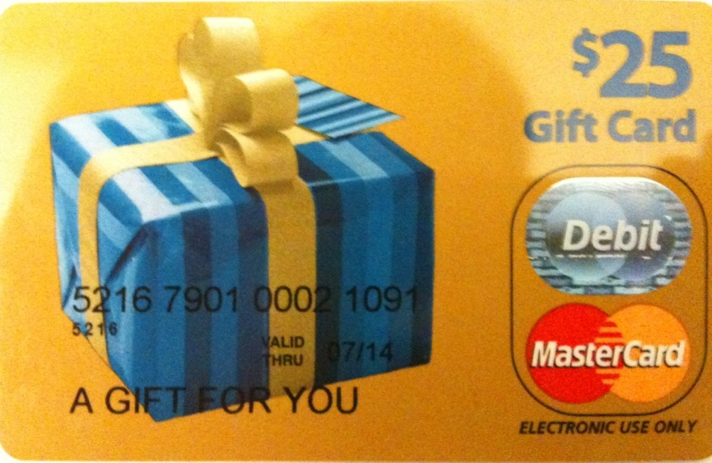



Flaw & exploit
Chuck, pay in Amazon with this signed letter:
Amazon, I want to pay with this letter
Dear Amazon,
order#123 is $10, when it is paid, text me at 425-111-2222.
[Jeff's signature]
Anyone can register an Amazon seller account, so can Chuck.
We purchased a $25 MasterCard gift card by cash
We registered it under the name "Mark Smith" with fake address/phone number
Registered for seller accounts in PayPal, Amazon and Google using the card
Great, I will ship order#123!
Jeff,
I want to buy this DVD.
Dear Amazon,
order#123 is $10, when it is paid, text me at 425-111-2222. [Jeff's signature] [Mark's signature]
Jeff
Hi,
$10 has been paid for order#123.
[Amazon's signature]
Shopper Chuck
(and seller Mark)
Chuck's trick
Pay to Mark (i.e., Chuck himself), but check out from Jeff
Amazon is tricked to tell Jeff a payment between Chuck and Mark
Jeff is confused by Amazon
Amazon
(CaaS)

Slide 27
Other Attacks
Buffer overflow attack (stack/heap)
ROP attack
Password attack
Phishing attack
XSS attack
SQL injection attack
Integer overflow attack
Social engineering attack
Side-channel attack
…

Slide 28
Security: Real World VS. Computer
Security in general not a particularly new concern
Banks, military, legal system, etc. have always worried about security
Similarities with computer security:
Want to compartmentalize (different keys for bike vs. safe deposit box)
Log and audit for compromises
Use legal system for deterrence

Slide 29
Security: Real World VS. Computer
Significant differences with computer security:
Internet makes attacks fast, cheap, and scalable
Huge number of adversaries: bored teenagers, criminals worldwide, etc.
Anonymous adversaries : no strong identity on the internet
Adversaries have lots of resources (compromised PCs in a botnet)
Attacks can often be automated: systems compromised faster than can react
Users often have poor intuition about computer security
E.g., misunderstand implications of important security decisions

Slide 30
Why is Security So Hard?
Security is a negative goal
Want to achieve something despite whatever adversary might do
A positive goal: "XYB can read exam.txt".
Ask XYB to check if our system meets this positive goal
A negative goal: "Ben cannot read exam.txt".
Ask John if he can read exam.txt?
Good to check, but not nearly enough..
Must reason about all possible ways in which John might get the data
How might Ben try to get the contents of exam.txt?
Notes:
We've seen negative goals already: all-or-nothing atomicity w/ crashes.
With crashes, just had to think of where we might crash.
Much harder to consider all possible cases with an adversary.
Security is also often hard because system has many complex goals.

Slide 31
Ways to Access exam.txt
Change permissions on exam.txt to get access
Access disk blocks directly
Access exam.txt via ipads.se.sjtu.edu.cn
Reuse memory after XYB's text editor exits, read data
Read backup copy of exam.txt from XYB's text editor
Intercept network packets to file server storing exam.txt
Send XYB a trojaned text editor that emails out the file
Steal disk from file server storing exam.txt
Get discarded printout of exam.txt from the trash
Call sysadmin, pretend to be XYB, reset his password
… when should we stop thinking of more ways?

Slide 32
Fault Tolerant Fails Here
Why not using fault tolerant techniques?
Since security can be seen as a kind of fault
Two reasons
Result of "fault" may be too much (cannot afford once)
E.g., exam leakage, rocket launching
Failures due to attack might be highly correlated
In fault-tolerance, we assumed independent failures

Slide 33
Much Harder to Reason about Security
No complete solution; we can't always secure every system
Trust nothing that you didn't create yourself
What are we going to learn?
How to model systems in the context of security
How we think about and assess risks
Techniques for assessing common risks
There are things we can do to make systems more secure
Know trade-offs
Security vs. performance, security vs. convenience, and security vs. simplicity

Slide 34
2 Steps towards Building a More Secure System
How to make progress in building a secure system?
Be clear about goals: "policy"
Be clear about assumptions: "threat model"

Slide 35
Policy: Goals
Information security goals:
Confidentiality: limit who can read data
Integrity: limit who can write data
Liveness goals:
Availability: ensure service keeps operating

Slide 36
Threat Model: Assumptions
Often don't know in advance who might attack, or what they might do
Adversaries may have different goals, techniques, resources, expertise
Cannot be secure against arbitrary adversaries
as we saw with Ben vs. XYB
Adversary might be your hardware vendor, software vendor, administrator, …
Need to make some plausible assumptions to make progress

Slide 37
Threat Model: Assumptions
What does a threat model look like?
Adversary controls some computers, networks (but not all)
Adversary controls some software on computers he doesn't fully control
Adversary knows some information, such as passwords or keys (but not all)
Adversary knows about bugs in your software?
Physical attacks?
Social engineering attacks?
Resources? (Can be hard to estimate either resources or requirements!)

Slide 38
Threat Model: Assumptions
Unrealistic / incomplete threat models
Adversary is outside of the company network / firewall
Adversary doesn't know legitimate users' passwords
Adversary won't figure out how the system works
Despite this, important to have a threat model
Can reason about assumptions, evolve threat model over time
When a problem occurs, can figure out what exactly went wrong and re-design
Overly-ambitious threat models not always a good thing
Not all threats are equally important
Stronger requirements can lead to more complexity
Complex systems can develop subtle security problems

Slide 39

Guard Model

Slide 40
Guard Model of Security
Complete mediation
Only way to access the resource involves the guard
1. Must enforce client-server modularity
Adversary should not be able to access server's resources directly
E.g., assume OS enforces modularity, or run server on separate machine
2. Must ensure server properly invokes the guard in all the right places

Slide 41
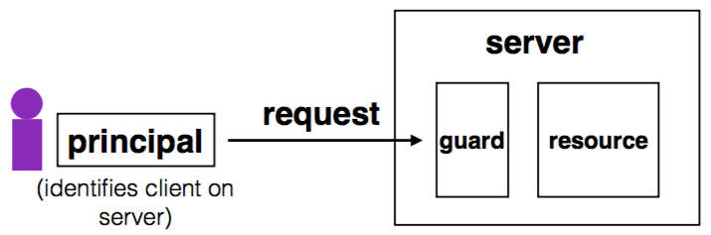
Complete Mediation
Guard typically provides:
Authentication: is the principal who they claim to be?
Authorization: does principal have access to perform request on resource?

Slide 42
Designing the Guard
Two functions often provided by a guard:
Authentication: request -> principal
E.g., client's username, verified using password
Authorization: (request, principal, resource) -> allow?
E.g., consult access control list (ACL) for resource
Simplifies security
Can consider the guards under threat model
But don't forget about complete mediation

Slide 43
Example: Unix FS
Resource: files, directories.
Server: OS kernel.
Client: process.
Requests: read, write system calls.
Mediation: U/K bit / system call implementation.
Principal: user ID.
Authentication: kernel keeps track of user ID for each process.
Authorization: permission bits & owner uid in each file's inode.

Slide 44
Example: Web Server
Resource: Wiki pages
Client: any computer that speaks HTTP
Server: web application, maybe written in Python
Requests: read/write wiki pages
Mediation: server stores data on local disk, accepts only HTTP reqs
Principal: username
Authentication: password
Authorization: list of usernames that can read/write each wiki page
Notes:
Note: requires setting file permissions, etc; assumes OS kernel provides complete mediation.

Slide 45
Example: Firewall
Resource: internal servers
Client: any computer sending packets
Server: the entire internal network
Requests: packets
Mediation:
internal network must not be connected to internet in other ways
no open wifi access points on internal network for adversary to use
no internal computers that might be under control of adversary
Principal, authentication: none
Authorization: check for IP address & port in table of allowed connections

Slide 46
What Can Go Wrong?
1. Bypass complete mediation by software bugs
2. Bypass complete mediation by an adversary
3. Policy vs. mechanism
4. Interactions between layers, components
5. Users make mistakes
6. Cost of security

Slide 47
Bypassing Complete Mediation
All ways to access resource must be checked by guard
Common estimate: one bug per 1,000 lines of code
Adversary may trick server code to do something unintended, bypass guard
How to prevent bypassing?
Reduce complexity: reduce lines of code
The "principle of least privilege"

Slide 48
Example: Paymaxx.com (2005)
https://my.paymaxx.com/
Requires username and password
If you authenticate, provides menu of options
One option is to get a PDF of the tax form
https://my.paymaxx.com/get-w2.cgi?id=1234
Gets a PDF of W2 tax form for ID 1234
get-w2.cgi forgot to check authorization
Attacker manually constructs URLs to fetch all data

Slide 49
Example: SQL Injection
username | email | public?
matei | matei@sjtu.edu.cn | yes
mike | mcarbin@sjtu.edu.cn | yes
katrina | lacurts@sjtu.edu.cn | no
SELECT username, email FROM users WHERE
username='<username>' AND public='yes'
Let <username> = katrina' OR username='
SELECT username, email FROM users WHERE
username='katrina' OR username='' AND
public='yes'

Slide 50
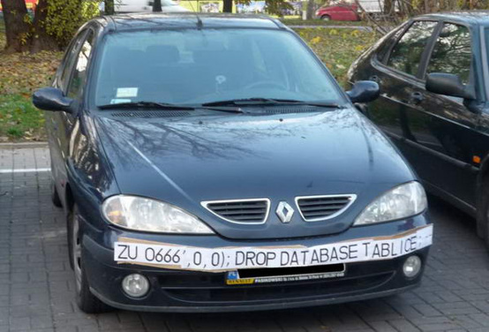
SQL Injection
ZU 0666',0,0);; DROP DATABASE TABLICE;

